Slide 1
Exception ,Error Handling and Basic I/O
Exception & Error Handling

Slide 2
Exception
What is Exception
Exception Handling
What is Error
Advantage of Exception Handling
Hierarchy of Exception Class
Types of Exception
Exception Example
Scenarios where an exception may occur

Slide 3
What is Exception in Java
Dictionary Meaning: Exception is an abnormal condition.
In Java, an exception is an event that disrupts the normal flow of the program. It is an object which is thrown at runtime.

Slide 4
Exception Handling in Java
The Exception Handling in Java is one of the powerful mechanism to handle the runtime errors so that the normal flow of the application can be maintained.
In this tutorial, we will learn about Java exceptions, it's types, and the difference between checked and unchecked exceptions.

Slide 5
What is Exception Handling
Exception Handling is a mechanism to handle runtime errors such as ClassNotFoundException, IOException, SQLException, RemoteException, etc.

Slide 6
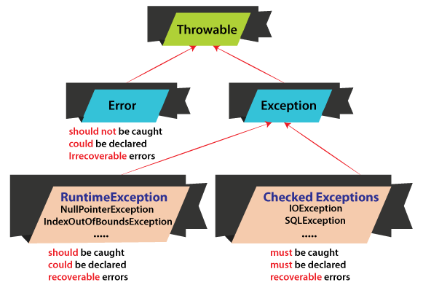
Error
error is an action that is inaccurate or incorrect.
In Java, Exception, and Error both are subclasses of the Java Throwable class that belongs to java.lang package.

Slide 7
What is an Error in Java
n Java, an error is a subclass of Throwable that tells that something serious problem is existing and a reasonable Java application should not try to catch that error. Generally, it has been noticed that most of the occurring errors are abnormal conditions and cannot be resolved by normal conditions. As these errors are abnormal conditions and should not occur, thus, error and its subclass are referred to as Unchecked Exceptions. In Java, we have the concept of errors as well as exceptions. Thus there exist several differences between an exception and an error. Errors cannot be solved by any handling techniques, whereas we can solve exceptions using some logic implementations. So, when an error occurs, it causes termination of the program as errors cannot try to catch.

Slide 8
Error Name Description
AbstractMethodError When a Java application tries to invoke an abstract method.
Error Indicating a serious but uncatchable error is thrown. This type of error is a subclass of Throwable.
AssertionError To indicate that an assertion has failed.
ClassCircularityError While initializing a class, a circularity is detected.
IllegalAccessError A Java application attempts either to access or modify a field or maybe invoking a method to which it does not have access.
ClassFormatError When JVM attempts to read a class file and find that the file is malformed or cannot be interpreted as a class file.
InstantiationError In case an application is trying to use the Java new construct for instantiating an abstract class or an interface.
ExceptionInInitializerError Signals that tell an unexpected exception have occurred in a static initializer.
InternalError Indicating the occurrence of an unexpected internal error in the JVM.
IncompatibleClassChangeError When an incompatible class change has occurred to some class of definition.

Slide 9
Hierarchy of Java Exception classes
The java.lang.Throwable class is the root class of Java Exception hierarchy inherited by two

Slide 10
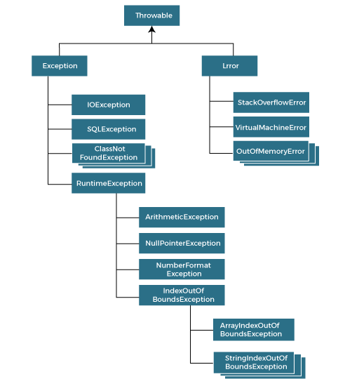
Hierarchy

Slide 11
When an error is detected, an exception is thrown.
Any exception that is thrown must be caught by the exception handler.
If the programmer has forgotten to provide an exception handler, the exception will be caught by the catch-all exception handler provided by the system.
Exception may be rethrown if exception handler is failure to handle it.

Slide 12
Advantages of Exceptions
It separates error handling code from regular code.
It has the ability to propagate error reporting up the call stack of methods.
The grouping or categorizing of exceptions is a natural outcome of the class hierarchy.

Slide 13
understand the exception through a Java program.
import java.util.Scanner;
public class ExcptionExample
{
public static void main(String args[])
{
Scanner sc = new Scanner(System.in);
System.out.print("Enter a number: ");
int number = sc.nextInt();
System.out.println("You have entered: "+number);
}
}

Slide 14
The core advantage of exception handling is to maintain the normal flow of the application. An exception normally disrupts the normal flow of the application; that is why we need to handle exceptions. Let's consider a scenario:
statement 1;
statement 2;
statement 3;
statement 4;
statement 5;//exception occurs
statement 6;
statement 7;
statement 8;
statement 9;
statement 10;
Suppose there are 10 statements in a Java program and an exception occurs at statement 5; the rest of the code will not be executed, i.e., statements 6 to 10 will not be executed. However, when we perform exception handling, the rest of the statements will be executed. That is why we use exception handling in Java

Slide 15
Java try-catch block
Java try block is used to enclose the code that might throw an exception. It must be used within the method.
If an exception occurs at the particular statement in the try block, the rest of the block code will not execute. So, it is recommended not to keep the code in try block that will not throw an exception.
Java try block must be followed by either catch or finally block.

Slide 16
Syntax of Java try-catch
try{
//code that may throw an exception
}catch(Exception_class_Name ref){}
Syntax of try-finally block
try{
//code that may throw an exception
}finally{}

Slide 17
Java catch block
Java catch block is used to handle the Exception by declaring the type of exception within the parameter. The declared exception must be the parent class exception ( i.e., Exception) or the generated exception type. However, the good approach is to declare the generated type of exception.

Slide 18
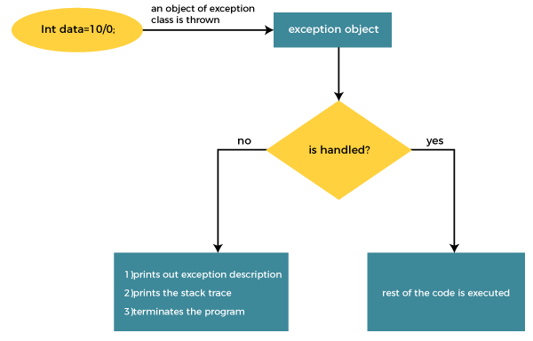

Slide 19
public class TryCatchExample6 {
public static void main(String[] args) {
int i=50;
int j=0;
int data;
try
{
data=i/j; //may throw exception
}
// handling the exception
catch(Exception e)
{
// resolving the exception in catch block
System.out.println(i/(j+2));
}
}
}

Slide 20
public class TryCatchExample6 {
public static void main(String[] args) {
int i=50;
int j=0;
int data;
try
{
data=i/j; //may throw exception
}
// handling the exception
catch(Exception e)
{
// resolving the exception in catch block
System.out.println(i/(j+2));
}
}
}

Slide 21
Java Nested try block
In Java, using a try block inside another try block is permitted. It is called as nested try block. Every statement that we enter a statement in try block, context of that exception is pushed onto the stack.
For example, the inner try block can be used to handle ArrayIndexOutOfBoundsException while the outer try block can handle the ArithemeticException (division by zero).

Slide 22
Why use nested try block
Sometimes a situation may arise where a part of a block may cause one error and the entire block itself may cause another error. In such cases, exception handlers have to be nested.

Slide 23
Syntax:
....
//main try block
try
{
statement 1;
statement 2; //try catch block within another try block
try
{
statement 3;
statement 4; //try catch block within nested try block
try
{
statement 5;
statement 6;
}
catch(Exception e2)
{
//exception message
}
}
catch(Exception e1)
{
//exception message
}
}
//catch block of parent (outer) try block
catch(Exception e3)
{
//exception message
}

Slide 24
Syntax:
....
//main try block
try
{
statement 1;
statement 2; //try catch block within another try block
try
{
statement 3;
statement 4; //try catch block within nested try block
try
{
statement 5;
statement 6;
}
catch(Exception e2)
{
//exception message
}
}
catch(Exception e1)
{
//exception message
}
}
//catch block of parent (outer) try block
catch(Exception e3)
{
//exception message
}

Slide 25
Why use nested try block
Sometimes a situation may arise where a part of a block may cause one error and the entire block itself may cause another error. In such cases, exception handlers have to be nested.

Slide 26
example
Let's see an example where we place a try block within another try block for two different exceptions.

Slide 27
public class NestedTryBlock{
public static void main(String args[]){
//outer try block
try{
//inner try block 1
try{
System.out.println("going to divide by 0");
int b =39/0;
}
//catch block of inner try block 1
catch(ArithmeticException e)
{
System.out.println(e);
}
//inner try block 2
try{
int a[]=new int[5];
//assigning the value out of array bounds
a[5]=4;
}
//catch block of inner try block 2
catch(ArrayIndexOutOfBoundsException e)
{
System.out.println(e);
}
System.out.println("other statement");
}
//catch block of outer try block
catch(Exception e)
{
System.out.println("handled the exception (outer catch)");
}
System.out.println("normal flow..");
}
}

Slide 28
Java finally block
Java finally block is a block used to execute important code such as closing the connection, etc.
Java finally block is always executed whether an exception is handled or not. Therefore, it contains all the necessary statements that need to be printed regardless of the exception occurs or not.

Slide 29
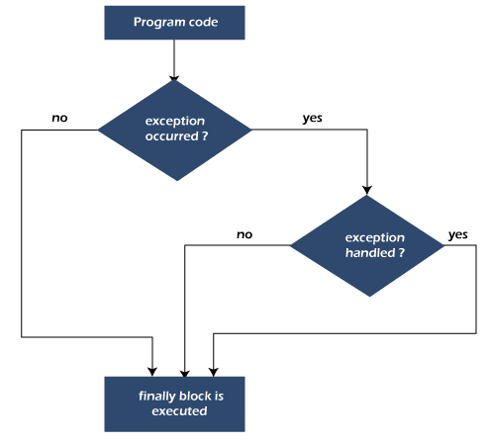
The finally block follows the try-catch block. Flowchart of finally block

Slide 30
Why use Java finally block
finally block in Java can be used to put "cleanup" code such as closing a file, closing connection, etc.
The important statements to be printed can be placed in the finally block.

Slide 31
Usage of Java finally
Let's see the different cases where Java finally block can be used.
Case 1: When an exception does not occur
Case 2: When an exception occurr but not handled by the catch block
Case 3: When an exception occurs and is handled by the catch block

Slide 32
Java throw Exception
In Java, exceptions allows us to write good quality codes where the errors are checked at the compile time instead of runtime and we can create custom exceptions making the code recovery and debugging easier.

Slide 33
Java throw keyword
The Java throw keyword is used to throw an exception explicitly.
We specify the exception object which is to be thrown. The Exception has some message with it that provides the error description. These exceptions may be related to user inputs, server, etc.
We can throw either checked or unchecked exceptions in Java by throw keyword. It is mainly used to throw a custom exception. We will discuss custom exceptions later in this section.

Slide 34
The Java throw keyword is used to throw an exception explicitly.
We specify the exception object which is to be thrown. The Exception has some message with it that provides the error description. These exceptions may be related to user inputs, server, etc.
We can throw either checked or unchecked exceptions in Java by throw keyword. It is mainly used to throw a custom exception. We will discuss custom exceptions later in this section.

Slide 35
example
public class TestThrow1 {
//function to check if person is eligible to vote or not
public static void validate(int age) {
if(age<18) {
//throw Arithmetic exception if not eligible to vote
throw new ArithmeticException("Person is not eligible to vote");
}
else {
System.out.println("Person is eligible to vote!!");
}
}
//main method
public static void main(String args[]){
//calling the function
validate(13);
System.out.println("rest of the code...");
}
}

Slide 36
Java throws keyword
The Java throws keyword is used to declare an exception. It gives an information to the programmer that there may occur an exception. So, it is better for the programmer to provide the exception handling code so that the normal flow of the program can be maintained.
Exception Handling is mainly used to handle the checked exceptions. If there occurs any unchecked exception such as NullPointerException, it is programmers' fault that he is not checking the code before it being used.

Slide 37
Syntax of Java throws
return_type method_name() throws exception_class_name{
//method code
}
Which exception should be declared?
Ans: Checked exception only, because:
unchecked exception: under our control so we can correct our code.
error: beyond our control. For example, we are unable to do anything if there occurs VirtualMachineError or StackOverflowError.

Slide 38
Advantage of Java throws keyword
Now Checked Exception can be propagated (forwarded in call stack).
It provides information to the caller of the method about the exception

Slide 39
example
Java throws Example
Let's see the example of Java throws clause which describes that checked exceptions can be propagated by throws keyword.
Testthrows1.java
import java.io.IOException;
class Testthrows1{
void m()throws IOException{
throw new IOException("device error");//checked exception
}
void n()throws IOException{
m();
}
void p(){
try{
n();
}catch(Exception e){System.out.println("exception handled");}
}
public static void main(String args[]){
Testthrows1 obj=new Testthrows1();
obj.p();
System.out.println("normal flow...");
}
}
Test it Now

Slide 40
There are two cases:
Case 1: We have caught the exception i.e. we have handled the exception using try/catch block.
Case 2: We have declared the exception i.e. specified throws keyword with the method.
C

Slide 41
Case 1: Handle Exception Using try-catch block
n case we handle the exception, the code will be executed fine whether exception occurs during the program or not.
Testthrows2.java
import java.io.*;
class M{
void method()throws IOException{
throw new IOException("device error");
}
}
public class Testthrows2{
public static void main(String args[]){
try{
M m=new M();
m.method();
}catch(Exception e){System.out.println("exception handled");}
System.out.println("normal flow...");
}
}
Test it Now

Slide 42
Case 2: Declare Exception
In case we declare the exception, if exception does not occur, the code will be executed fine.
In case we declare the exception and the exception occurs, it will be thrown at runtime because throws does not handle the exception.
Let's see examples for both the scenario.
A) If exception does not occur
Testthrows3.java
import java.io.*;
class M{
void method()throws IOException{
System.out.println("device operation performed");
}
}
class Testthrows3{
public static void main(String args[])throws IOException{//declare exception
M m=new M();
m.method();
System.out.println("normal flow...");
}
}

Slide 43
B) If exception occurs
import java.io.*;
class M{
void method()throws IOException{
throw new IOException("device error");
}
}
class Testthrows4{
public static void main(String args[])throws IOException{//declare exception
M m=new M();
m.method();
System.out.println("normal flow...");
}
}

Slide 44
Chained Exception in Java
Two new constructors and two new methods were added to Throwable class to support chained exception.
Throwable(Throwable cause)
Throwable(String str, Throwable cause)
In the first constructor, the paramter cause specifies the actual cause of exception. In the second form, it allows us to add an exception description in string form with the actual cause of exception.

Slide 45
Chained Exception
getCause() method returns the actual cause associated with current exception.
initCause() set an underlying cause(exception) with invoking exception.

Slide 46
Basic I/O
Java I/O (Input and Output) is used to process the input and produce the output.
Java uses the concept of a stream to make I/O operation fast. The java.io package contains all the classes required for input and output operations.
We can perform file handling in Java by Java I/O API.

Slide 47
Stream
A stream is a sequence of data. In Java, a stream is composed of bytes. It's called a stream because it is like a stream of water that continues to flow.
In Java, 3 streams are created for us automatically. All these streams are attached with the console.
1) System.out: standard output stream
2) System.in: standard input stream
3) System.err: standard error stream

Slide 48
OutputStream
Java application uses an output stream to write data to a destination; it may be a file, an array, peripheral device or socket.

Slide 49
InputStream
Java application uses an input stream to read data from a source; it may be a file, an array, peripheral device or socket.
Let's understand the working of Java OutputStream and InputStream by the figure given below.

Slide 50
InputStream

Slide 51
Basic I/O
Byte stream
ByteStream classes are used to read bytes from the input stream and write bytes to the output stream. In other words, we can say that ByteStream classes read/write the data of 8-bits. We can store video, audio, characters, etc., by using ByteStream classes. These classes are part of the java.io package.
The ByteStream classes are divided into two types of classes, i.e., InputStream and OutputStream. These classes are abstract and the super classes of all the Input/Output stream classes.

Slide 52
InputStream ClasS
The InputStream class provides methods to read bytes from a file, console or memory. It is an abstract class and can't be instantiated; however, various classes inherit the InputStream class and override its methods. The subclasses of InputStream class are given in the following table.

Slide 53
OutputStream Class
The OutputStream is an abstract class that is used to write 8-bit bytes to the stream. It is the superclass of all the output stream classes. This class can't be instantiated; however, it is inherited by various subclasses that are given in the following table.

Slide 54
import java.io.ByteArrayInputStream;
import java.io.File;
import java.io.FileInputStream;
import java.io.FileNotFoundException;
import java.io.FileOutputStream;
import java.io.IOException;
public class InputOutputStreamExample {
public static void main(String[] args) throws IOException {
// TODO Auto-generated method stub
byte content[] = "Jtp is the best website to learn new technologies".getBytes();
ByteArrayInputStream inputStream = new ByteArrayInputStream(content);
inputStream.read(content);
File newFile = new File("/Users/MyUser/Desktop/MyNewFile.doc");
FileOutputStream outputStream = new FileOutputStream(newFile);
outputStream.write(content);
}
}

Slide 55
CharacterStream Classes in Java
The java.io package provides CharacterStream classes to overcome the limitations of ByteStream classes, which can only handle the 8-bit bytes and is not compatible to work directly with the Unicode characters. CharacterStream classes are used to work with 16-bit Unicode characters. They can perform operations on characters, char arrays and Strings.
However, the CharacterStream classes are mainly used to read characters from the source and write them to the destination. For this purpose, the CharacterStream classes are divided into two types of classes, I.e., Reader class and Writer class.

Slide 56
Reader Class
Reader class is used to read the 16-bit characters from the input stream. However, it is an abstract class and can't be instantiated, but there are various subclasses that inherit the Reader class and override the methods of the Reader class. All methods of the Reader class throw an IOException. The subclasses of the Reader class are given in the following table.

Slide 57
Writer Class
Writer class is used to write 16-bit Unicode characters to the output stream. The methods of the Writer class generate IOException. Like Reader class, Writer class is also an abstract class that cannot be instantiated; therefore, the subclasses of the Writer class are used to write the characters onto the output stream. The subclasses of the Writer class are given in the below table.

Slide 58
Create a File in Java
How to Create a File in Java
In Java, creating a file is easy by using pre-defined classes and packages. There are three ways to create a file.
Using File.createNewFile() method
Using FileOutputStream class
Using File.createFile() method

Slide 59
Java File.createNewFile() method
The File.createNewFile() is a method of File class which belongs to a java.io package. It does not accept any argument. The method automatically creates a new, empty file. The method returns a boolean value:
true, if the file created successfully.
false, if the file already exists.
When we initialize File class object, we provide the file name and then we can call createNewFile() method of the File class to create a new file in Java.
The File.createNewFile() method throws java.io.IOException if an I/O error occurred. It also throws SecurityException if a security manager exists and its SecurityManager.checkWriter(java.lang.String) method denies write access to the file. The signature of the method is:
public boolean createNewFile() throws IOException

Slide 60
Java FileOutputStream
Java FileOutputStream
A file Output stream writes data to a file. Java FileOutputStream class also provide support for files. It belongs to the java.io package. It stores the data into bytes. We use FileOutputStream class when we need to write some data into the created file. The FileOutputStream class provides a constructor to create a file. The signature of the constructor is:

Slide 61
import java.io.FileOutputStream;
import java.util.Scanner;
public class CreateFileExample
{
public static void main(String args[])
{
try
{
Scanner sc=new Scanner(System.in); //object of Scanner class
System.out.print("Enter the file name: ");
String name=sc.nextLine(); //variable name to store the file name
FileOutputStream fos=new FileOutputStream(name, true); // true for append mode
System.out.print("Enter file content: ");
String str=sc.nextLine()+"\n"; //str stores the string which we have entered
byte[] b= str.getBytes(); //converts string into bytes
fos.write(b); //writes bytes into file
fos.close(); //close the file
System.out.println("file saved.");
}
catch(Exception e)
{
e.printStackTrace();
}
}
}

Slide 62
generic collections
The generic collections are introduced in Java 5 Version. The generic collections disable the type-casting and there is no use of type-casting when it is used in generics. The generic collections are type-safe and checked at compile-time. These generic collections allow the datatypes to pass as parameters to classes. The Compiler is responsible for checking the compatibility of the types.

Slide 63
Syntax
class<type>, interface<type>
Type safety
Generics allows a single type of object.
List list = new ArrayList(); // before generics
list.add(10);
list.add("100");
List<Integer> list1 = new ArrayList<Integer>(); // adding generics
list1.add(10);
list1.add("100"); // compile-time error.

Slide 64
Type Casting
No need for type-casting while using generics.
List<String> list = new ArrayList<String>();
list.add("Adithya");
String str = list.get(0); // no need of type-casting
Compile-time
The errors are checked at compile-time in generics.
List list = new ArrayList(); // before generics
list.add(10);
list.add("100");
List<Integer> list1 = new ArrayList<Integer>(); // adding generics
list1.add(10);
list1.add("100");// compile-time error
raja

Slide 65
Advantage of Java Generics
There are mainly 3 advantages of generics. They are as follows:
1) Type-safety: We can hold only a single type of objects in generics. It doesn?t allow to store other objects.

Slide 66
Without Generics, we can store any type of objects.
List list = new ArrayList();
list.add(10);
list.add("10");
With Generics, it is required to specify the type of object we need to store.
List<Integer> list = new ArrayList<Integer>();
list.add(10);
list.add("10");// compile-time error

Slide 67
2) Type casting is not required: There is no need to typecast the object.
Before Generics, we need to type cast.
List list = new ArrayList();
list.add("hello");
String s = (String) list.get(0);//typecasting
After Generics, we don't need to typecast the object.
List<String> list = new ArrayList<String>();
list.add("hello");
String s = list.get(0);

Slide 68
3) Compile-Time Checking: It is checked at compile time so problem will not occur at runtime. The good programming strategy says it is far better to handle the problem at compile time than runtime.
List<String> list = new ArrayList<String>();
list.add("hello");
list.add(32);//Compile Time Error
Syntax to use generic collection
ClassOrInterface<Type>
Example to use Generics in java
ArrayList<String>

Slide 69
mport java.util.*;
class TestGenerics1{
public static void main(String args[]){
ArrayList<String> list=new ArrayList<String>();
list.add("rahul");
list.add("jai");
//list.add(32);//compile time error
String s=list.get(1);//type casting is not required
System.out.println("element is: "+s);
Iterator<String> itr=list.iterator();
while(itr.hasNext()){
System.out.println(itr.next());
}
}
}

Slide 70
Type Parameters
The type parameters naming conventions are important to learn generics thoroughly. The common type parameters are as follows:
T - Type
E - Element
K - Key
N - Number
V - Value

Slide 71
Generic Method
Like the generic class, we can create a generic method that can accept any type of arguments. Here, the scope of arguments is limited to the method where it is declared. It allows static as well as non-static methods.
Let's see a simple example of java generic method to print array elements. We are using
here E to denote the element.

Slide 72
public class TestGenerics4{
public static < E > void printArray(E[] elements) {
for ( E element : elements){
System.out.println(element );
}
System.out.println();
}
public static void main( String args[] ) {
Integer[] intArray = { 10, 20, 30, 40, 50 };
Character[] charArray = { 'J', 'A', 'V', 'A', 'T','P','O','I','N','T' };
System.out.println( "Printing Integer Array" );
printArray( intArray );
System.out.println( "Printing Character Array" );
printArray( charArray );
}
}

Slide 73
Java Annotations
Java Annotation is a tag that represents the metadata i.e. attached with class, interface, methods or fields to indicate some additional information which can be used by java compiler and JVM.
Annotations in Java are used to provide additional information, so it is an alternative option for XML and Java marker interfaces.
First, we will learn some built-in annotations then we will move on creating and using custom annotations.

Slide 74
Java Annotations
Built-In Java Annotations used in Java code
@Override
@SuppressWarnings
@Deprecated
Built-In Java Annotations used in other annotations
@Target
@Retention
@Inherited
@Documented

Slide 75
Understanding Built-In Annotations
@Override
@Override annotation assures that the subclass method is overriding the parent class method. If it is not so, compile time error occurs.
Sometimes, we does the silly mistake such as spelling mistakes etc. So, it is better to mark @Override annotation that provides assurity that method is overridden.
class Animal{
void eatSomething(){System.out.println("eating something");}
}
class Dog extends Animal{
@Override
void eatsomething(){System.out.println("eating foods");}//should be eatSomething
}
class TestAnnotation1{
public static void main(String args[]){
Animal a=new Dog();
a.eatSomething();
}}

Slide 76
@SuppressWarnings
@SuppressWarnings annotation: is used to suppress warnings issued by the compiler.
import java.util.*;
class TestAnnotation2{
@SuppressWarnings("unchecked")
public static void main(String args[]){
ArrayList list=new ArrayList();
list.add("sonoo");
list.add("vimal");
list.add("ratan");
for(Object obj:list)
System.out.println(obj);
}}

Slide 77
@Deprecated
@Deprecated annoation marks that this method is deprecated so compiler prints warning. It informs user that it may be removed in the future versions. So, it is better not to use such methods.
class A{
void m(){System.out.println("hello m");}
@Deprecated
void n(){System.out.println("hello n");}
}
class TestAnnotation3{
public static void main(String args[]){
A a=new A();
a.n();
}}

Slide 78
Java Custom Annotations
Java Custom Annotations
Java Custom annotations or Java User-defined annotations are easy to create and use. The @interface element is used to declare an annotation. For example:
@interface MyAnnotation{}
Here, MyAnnotation is the custom annotation name.

Slide 79
Points to remember for java custom annotation signature
There are few points that should be remembered by the programmer.
Method should not have any throws clauses
Method should return one of the following: primitive data types, String, Class, enum or array of these data types.
Method should not have any parameter.
We should attach @ just before interface keyword to define annotation.
It may assign a default value to the method.

Slide 80
Types of Annotation
Marker Annotation
Single-Value Annotation
Multi-Value Annotation

Slide 81
1) Marker Annotation
An annotation that has no method, is called marker annotation. For example:
@interface MyAnnotation{}
The @Override and @Deprecated are marker annotations.

Slide 82
2 Single-Value Annotation
in annotation that has one method, is called single-value annotation. For example:
@interface MyAnnotation{
int value();
}
We can provide the default value also. For example:
@interface MyAnnotation{
int value() default 0;
}

Slide 83
How to apply Single-Value Annotation
Let's see the code to apply the single value annotation.
@MyAnnotation(value=10)

Slide 84
3) Multi-Value Annotation
n annotation that has more than one method, is called Multi-Value annotation. For example:
@interface MyAnnotation{
int value1();
String value2();
String value3();
}
}
We can provide the default value also. For example:
@interface MyAnnotation{
int value1() default 1;
String value2() default "";
String value3() default "xyz";
}

Slide 85
How to apply Multi-Value Annotation
Let's see the code to apply the multi-value annotation.
@MyAnnotation(value1=10,value2="Arun Kumar",value3="Ghaziabad")

Slide 86
Built-in Annotations used in custom annotations in java
@Target
@Retention
@Inherited
@Documented

Slide 87
@Target
@Target tag is used to specify at which type, the annotation is used.
The java.lang.annotation.ElementType enum declares many constants to specify the type of element where annotation is to be applied such as TYPE, METHOD, FIELD etc. Let's see the constants of ElementType enum:

Slide 88
Element Types Where the annotation can be applied
TYPE class, interface or enumeration
FIELD fields
METHOD methods
CONSTRUCTOR constructors
LOCAL_VARIABLE local variables
ANNOTATION_TYPE annotation type
PARAMETER parameter
E

Slide 89
Example to specify annoation for a class
@Target(ElementType.TYPE)
@interface MyAnnotation{
int value1();
String value2();
}
Example to specify annotation for a class, methods or fields
@Target({ElementType.TYPE, ElementType.FIELD, ElementType.METHOD})
@interface MyAnnotation{
int value1();
String value2();
}

Slide 90
@Retention
@Retention annotation is used to specify to what level annotation will be available.
RetentionPolicy Availability
RetentionPolicy.SOURCE :refers to the source code, discarded during compilation. It will not be available in the compiled class.
RetentionPolicy :.CLASS refers to the .class file, available to java compiler but not to JVM . It is included in the class file.
RetentionPolicy.RUNTIME :refers to the runtime, available to java compiler and JVM .

Slide 91
xample to specify the RetentionPolicy
@Retention(RetentionPolicy.RUNTIME)
@Target(ElementType.TYPE)
@interface MyAnnotation{
int value1();
String value2();
}

Slide 92
Example of custom annotation: creating, applying and accessing annotation
/Creating annotation
import java.lang.annotation.*;
import java.lang.reflect.*;
@Retention(RetentionPolicy.RUNTIME)
@Target(ElementType.METHOD)
@interface MyAnnotation{
int value();
}
//Applying annotation
class Hello{
@MyAnnotation(value=10)
public void sayHello(){System.out.println("hello annotation");}
}
//Accessing annotation
class TestCustomAnnotation1{
public static void main(String args[])throws Exception{
Hello h=new Hello();
Method m=h.getClass().getMethod("sayHello");
MyAnnotation manno=m.getAnnotation(MyAnnotation.class);
System.out.println("value is: "+manno.value());
}}

